Slide 1
Air Quality Prediction.
Group 5
Forecasting Air Pollution Trends With The Prophet Model

Slide 2
Table of contents
01
04
02
03
Methodology
Introduction
Overview of the project topic.
Outlines the approach used to forecast the air pollution trend.
Project
Objective
05
Result and Visualization
Displaying the model performance, findings through graphs.
Provides insight of what the prediction entails.
Dataset Description
06
Conclusion
Summary of the entire analysis.
Include air quality data with relevant environmental factors for forecasting.

Slide 3
Introduction
Air pollution has become a major environmental concern, affecting public health and climate conditions. This project includes prediction air quality based on various environmental factors using Python and machine learning techniques.
This project aims to predict Relative Humidity (RH) using historical air quality data from the Air Quality UCI dataset. By leveraging Facebook Prophet, a time-series forecasting model, we analyze past trends and forecast future values.

Slide 4
Project Objectives

Slide 5
OBJECTIVES
Analyze key air pollutant data to identify patterns.
Develop a predictive model for air quality classification.
Use Python-based machine learning techniques for prediction.
Provide insights into how environmental factors impact air quality.
Visualize trends and seasonal patterns

Slide 6
Datasets Description
The dataset contains air pollution data with the following features:
• Temperature (°C): Ambient air temperature.
• Humidity (%): Moisture content in the air.
• PM2.5 (µg/m³): Fine particulate matter(harmful
for respiratory health).
• PM10 (µg/m³): Coarse particulate matter.
• NO₂ (µg/m³): Nitrogen dioxide concentration.

Slide 7
Datasets Description – cont’d
• SO₂ (µg/m³): Sulfur dioxide concentration. • CO (mg/m³): Carbon monoxide concentration. • Proximity to Industrial Areas (km): Distance from industrial zones. • Population Density (people per km²): Number of people living in an area. • Air Quality (Target Variable): Categorical classification (e.g., 'Good,' 'Moderate,' etc.).

Slide 8
METHODOLOGY

Slide 9
Data Processing
0.1 Importing Required Libraries
```python import numpy as np import pandas as pd ```
0.2 Loading the Dataset
```python air_quality_data = pd.read_csv('/content/AirQualityUCI.csv', ) ```
0.3 Cleaning the Data
• Removing unnecessary columns • Handling missing values • Converting Date and Time into date time format

Slide 10
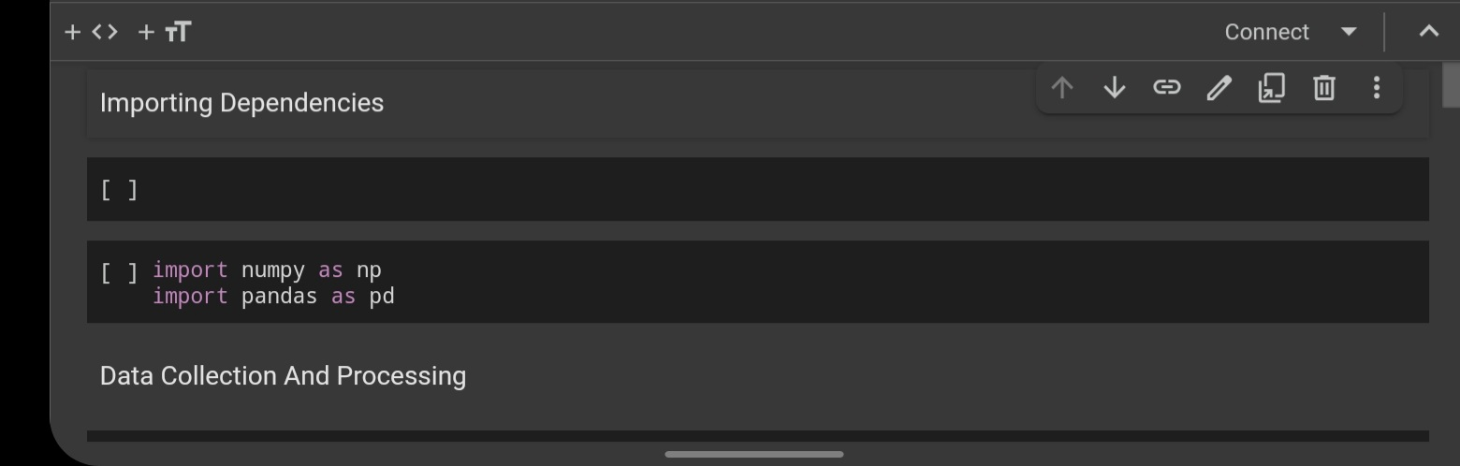
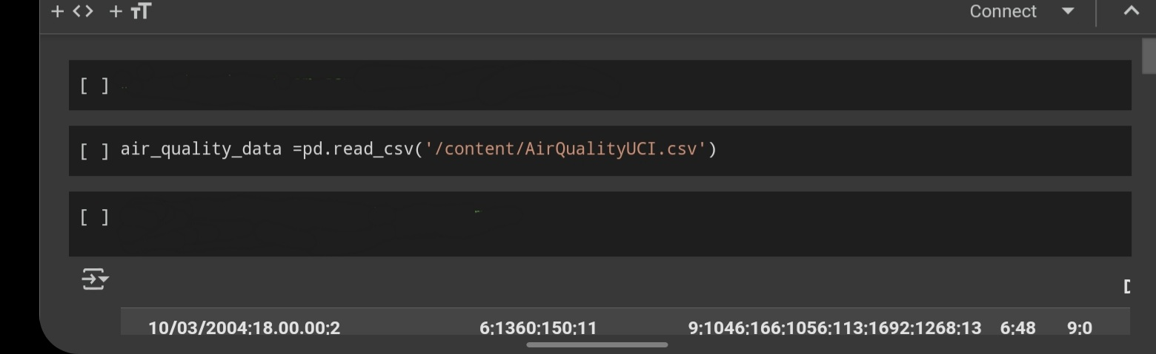

Slide 11
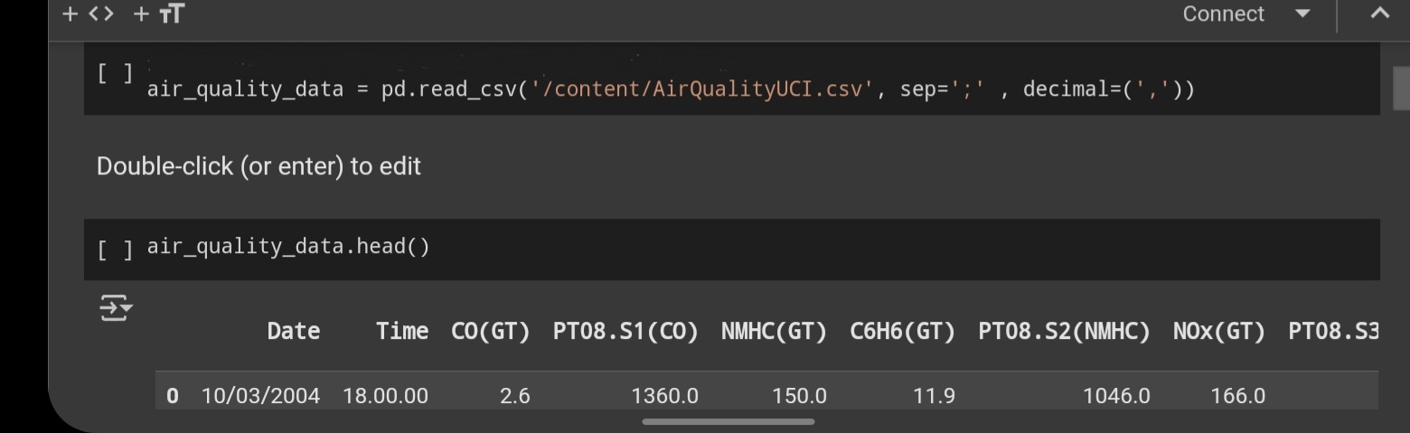
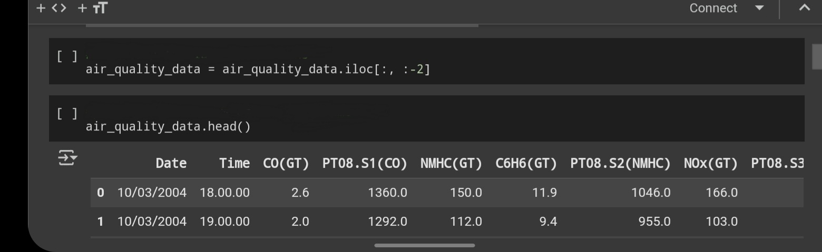

Slide 12
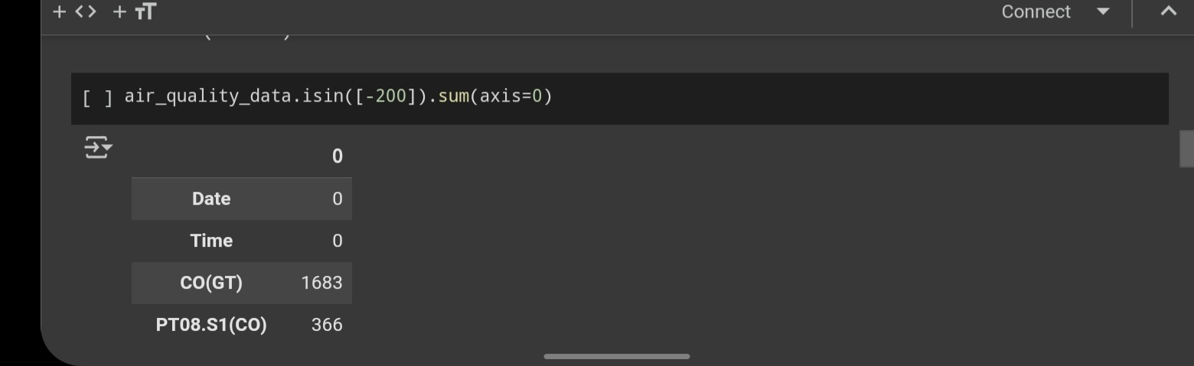
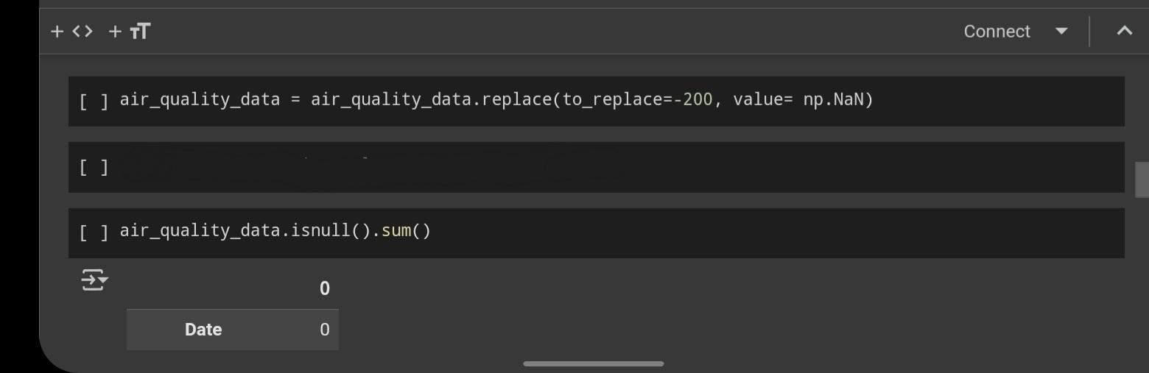

Slide 13
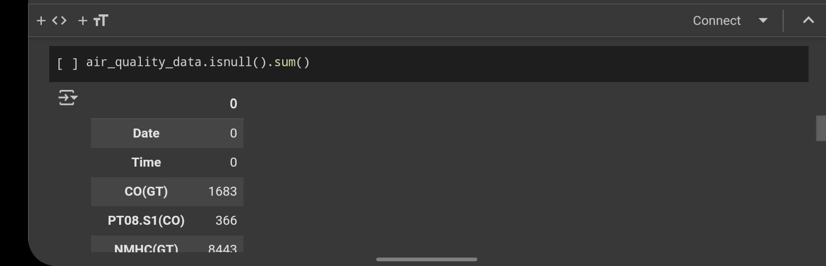
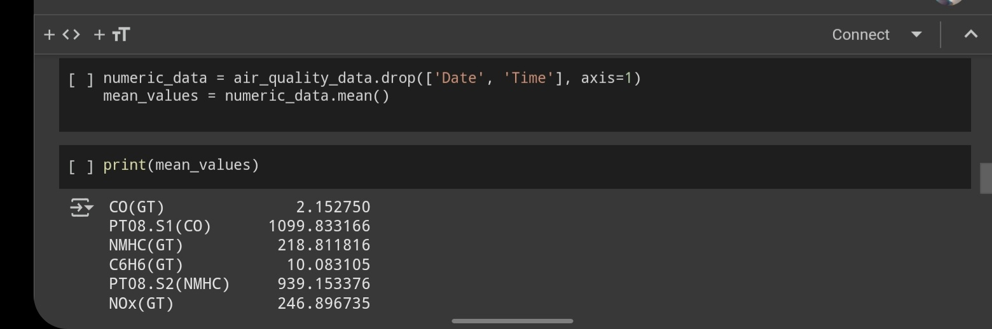

Slide 14
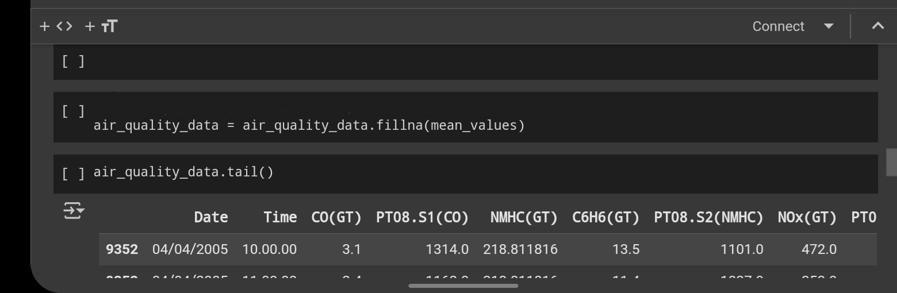
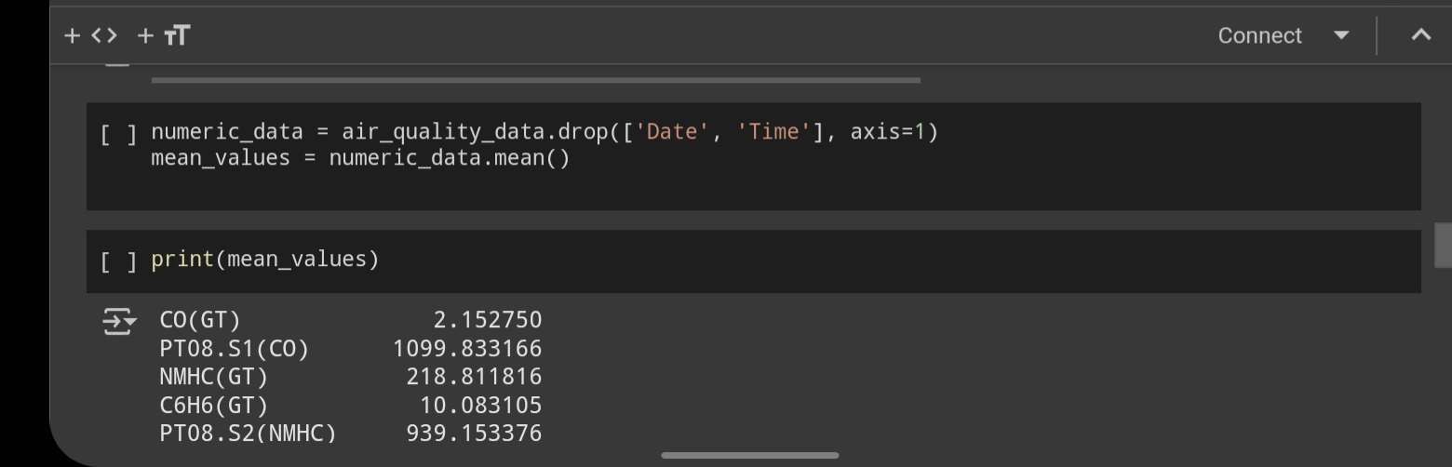

Slide 15
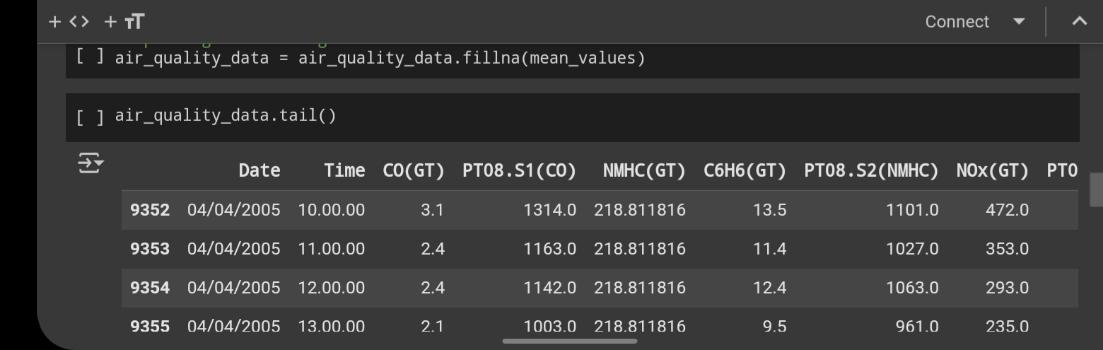
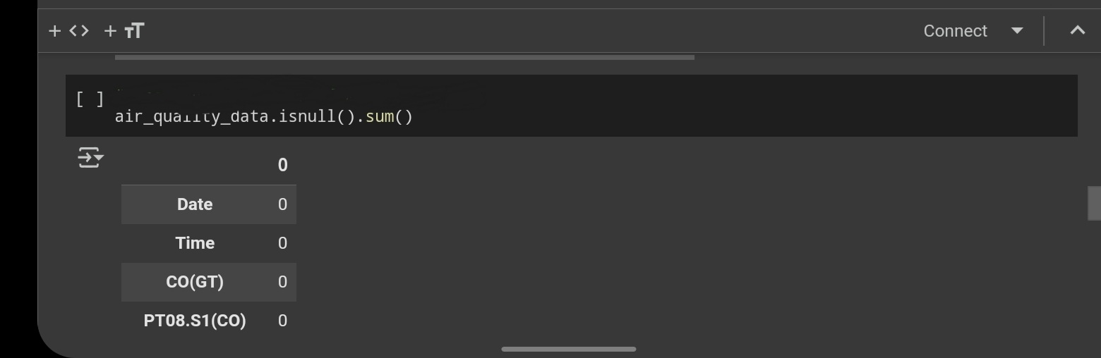

Slide 16
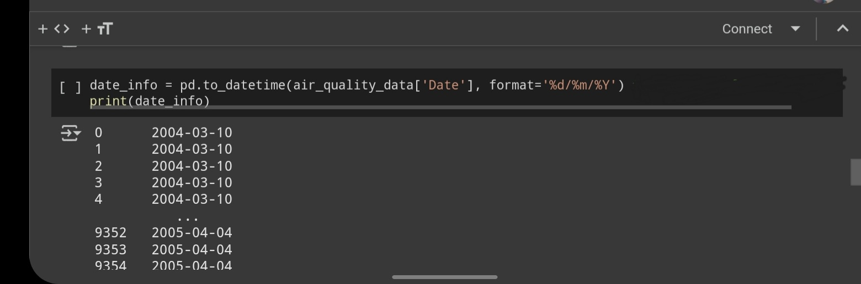
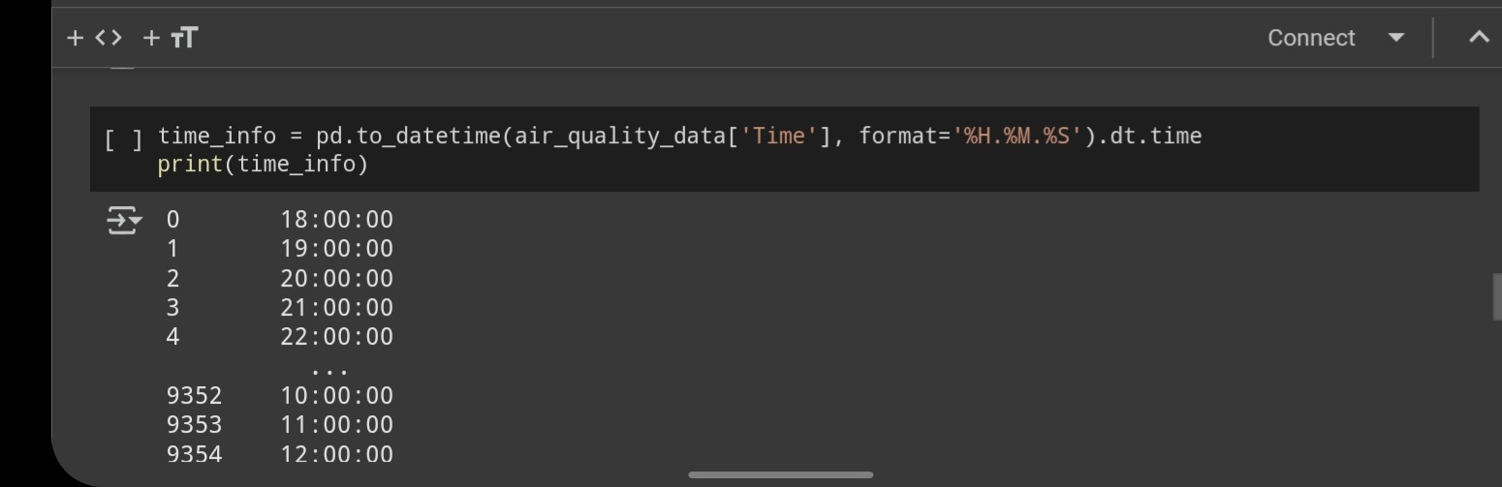

Slide 17
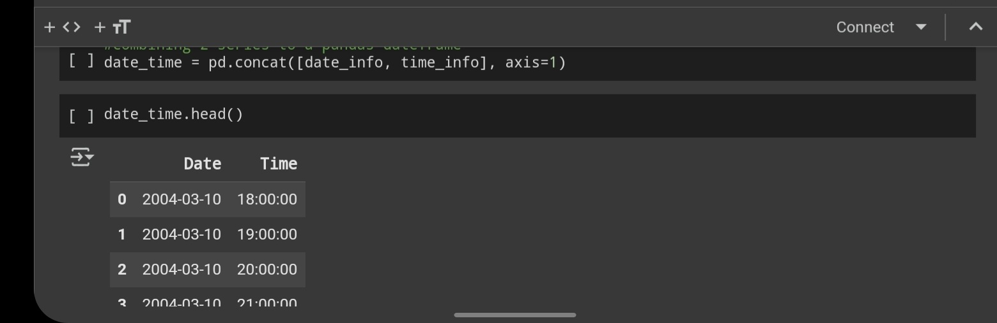
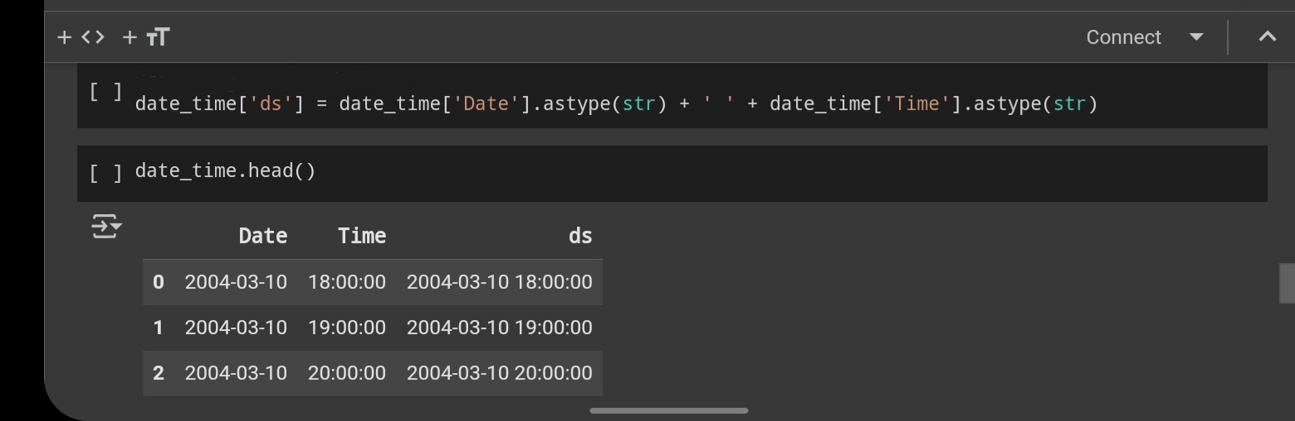

Slide 18
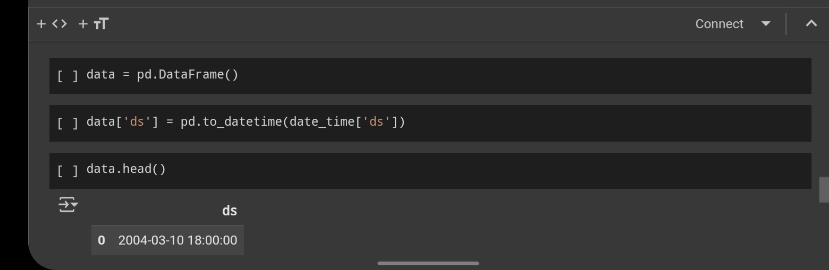
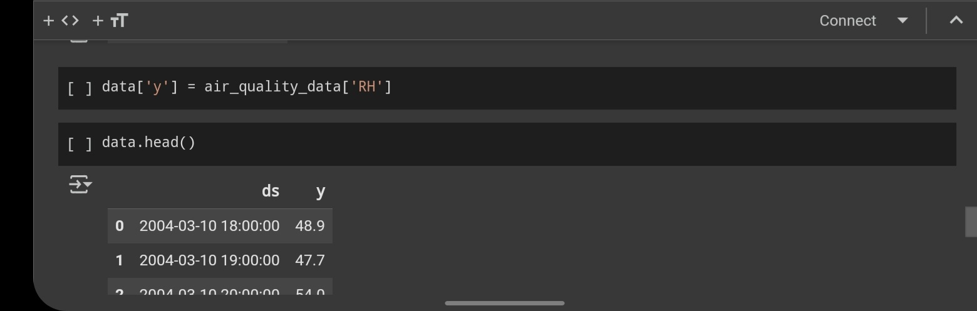

Slide 19
Model Training & Forecasting
Using Prophet, we train a model to forecast
Relative Humidity based on historical data.
Import Prophet libraries
from prophet import Prophet
import matplotlib.pyplot as plt
Training the Model
```python model = Prophet() model.fit(data)
Making Predictions
```python future = model.make_future_dataframe(periods=365, freq='H') forecast = model.predict(future

Slide 20
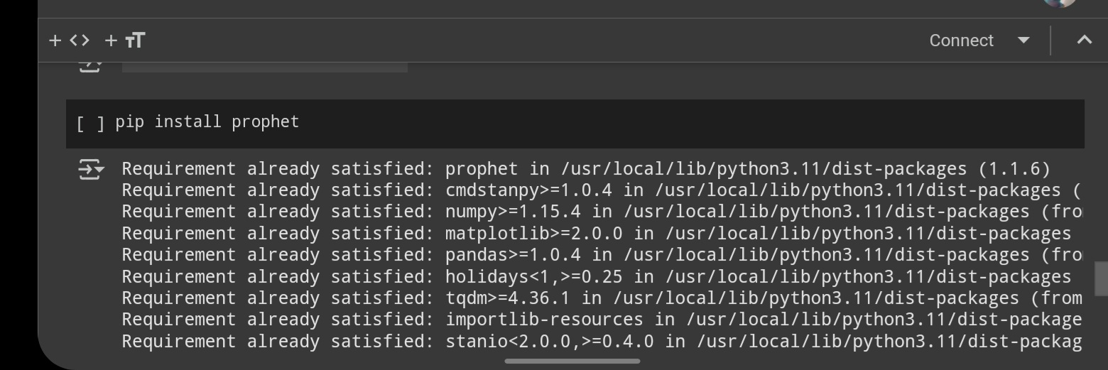
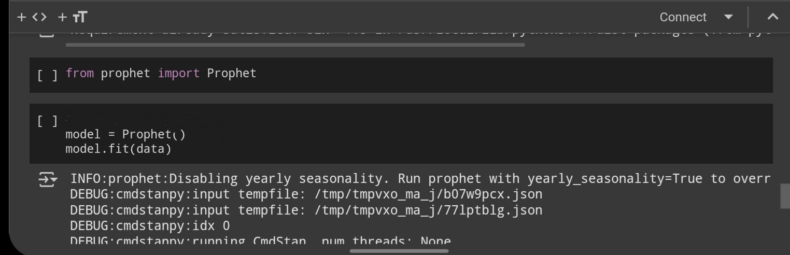

Slide 21
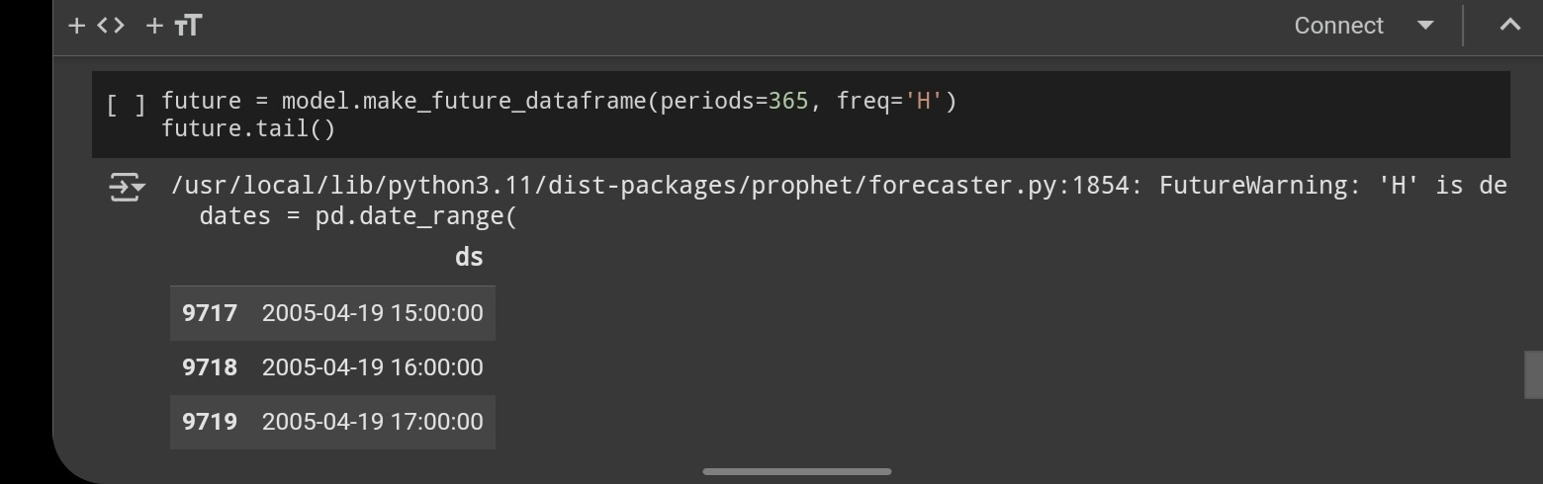
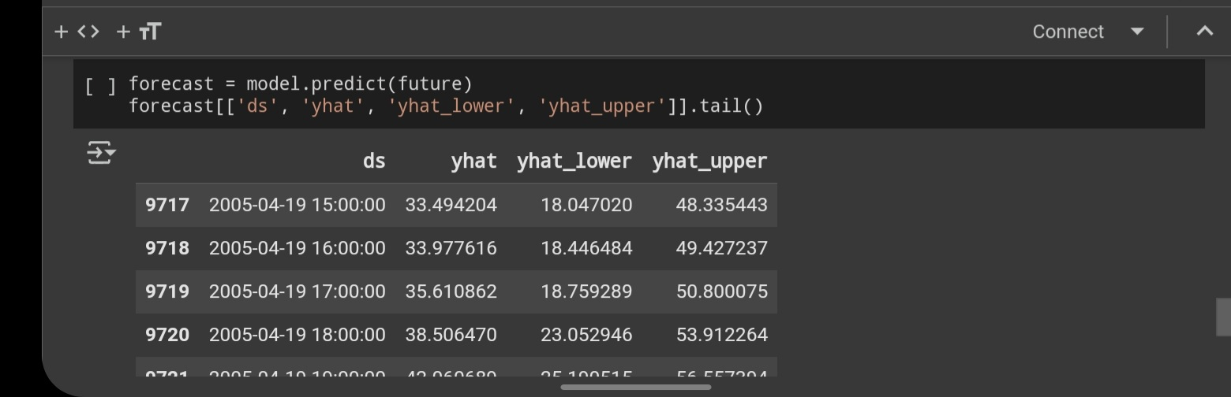

Slide 22
Result and Visualisation
Plotting the Forecast ```python fig1 = model.plot(forecast) plt.show() ```
The model's predictions are visualized using Prophet's built-in plotting functions.

Slide 23
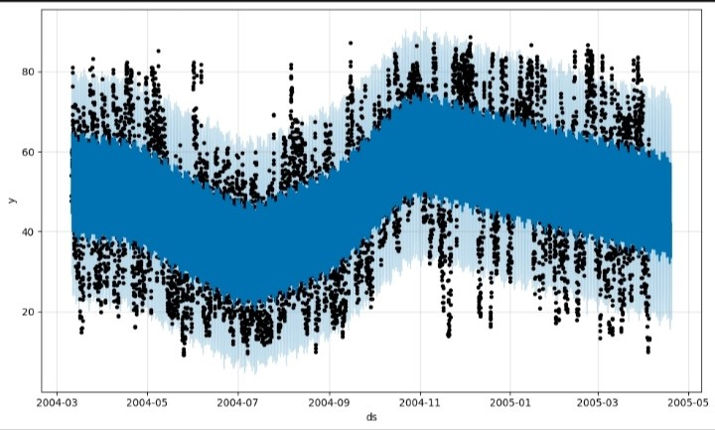

Slide 24
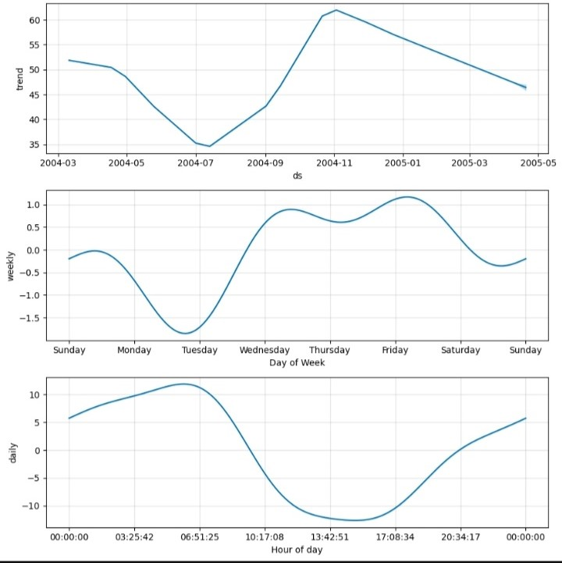

Slide 25
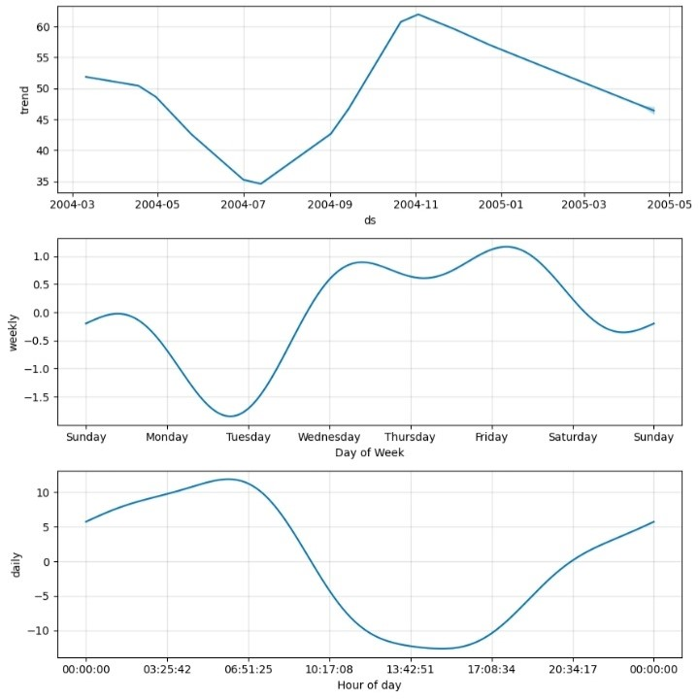

Slide 26
Conclusions
Summarize
key concepts
Real-world applications
Preview
next steps
Prophet effectively predicts humidity using past data and detects trends and seasonality. Further improvements can include using advanced models like LSTM and incorporating more weather variables.
The model can be enhanced by incorporating real-time sensor data from IoT devices to provide continuous updates and send alerts when pollution exceeds safe level.
Deploying the model in a web application for public and governmental use.

Slide 27
DARLINGTON YEBOAH GILBERT BC/ICT/22/036 DANIEL KWOFIE BC/ICT/22/065 JANESSA MENSAH ADOBEA BC/ICT/22/107 SELORM KOFI ASEM BC/ICT/22/067 ADI KOI AYISI ADDISON BC/ICT/22/008 ARABA JULIET ANDERSON ESSON BC/ICT/22/011 OBED BLANKSON BC/ICT/22/016 JOSHUA KWESI MENSAH BC/ICT/22/263
Thank
You!

